Slide 1
An analysis of changes in well-being during the COVID-19 pandemic in the UK using understanding society
Jennifer Murphy
and
Mark Elliot

Slide 2
Overall Purpose
To Investigate
the trajectory of well-being over the course of the first wave of the covid pandemic
whether the change in well-being is distributed equally across the population.
  Whether pre-existing medical conditions, social isolation, financial stress and deprivation were predictors for changes in well-being and
  whether there were community level characteristics which protect against decline.

Slide 3
Psychological effects of the pandemic, lockdown and contracting covid
Daheri et al (2021) Psychological Impact observed across 18 countries
Google trends data indicated and increase in terms like Loneliness worry and sadness during the initial stages; Brodeur et al 2021

Slide 4
Data and methods
the first four waves of the Understanding Society COVID-19 survey
  with wave nine of the main us survey used as the baseline.
outcome variable: the General Health Questionnaire (GHQ-12) caseness score.
  Impact of the onset of the pandemic/lockdown was captured through the difference between wave 9 of the main survey and wave 1 of the covid survey
  the trajectory through to the first relaxation of restrictions was measured through the first four waves.
Two different sets of OLS regression models – one for the initial response and the a separate one for the decline
  Wave 4 longitudinal weights were used in all models

Slide 5
Explanatory variables of interest
Deprivation Indicator (IMD-DECILE by LSOA)
Community Cohesion
Loneliness (and change therein)
Bassline wellbeing
  And for recovery model the size of change to wave 1
Financial crisis (use of Foodbanks in the last 4 weeks)
Reduction of income

Slide 6
Covariates
Age
Ethnic minority indicator
Deprivation Indicator (Existing health conditions indicator)

Slide 7

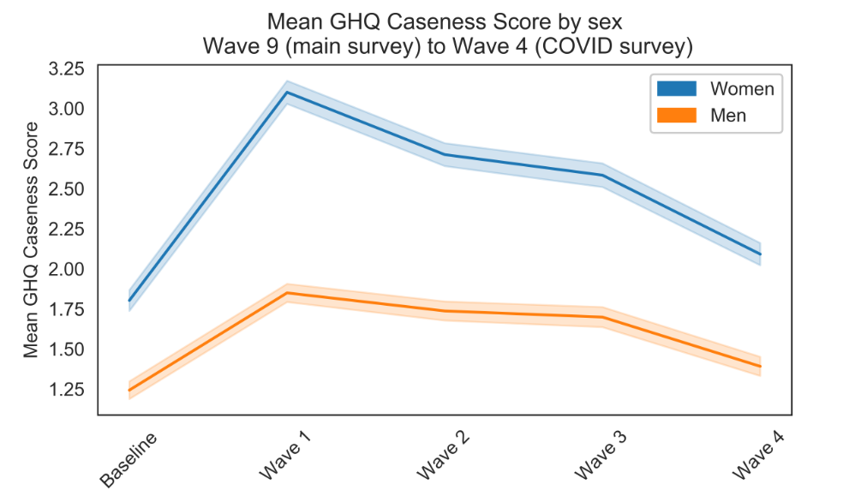

Slide 8
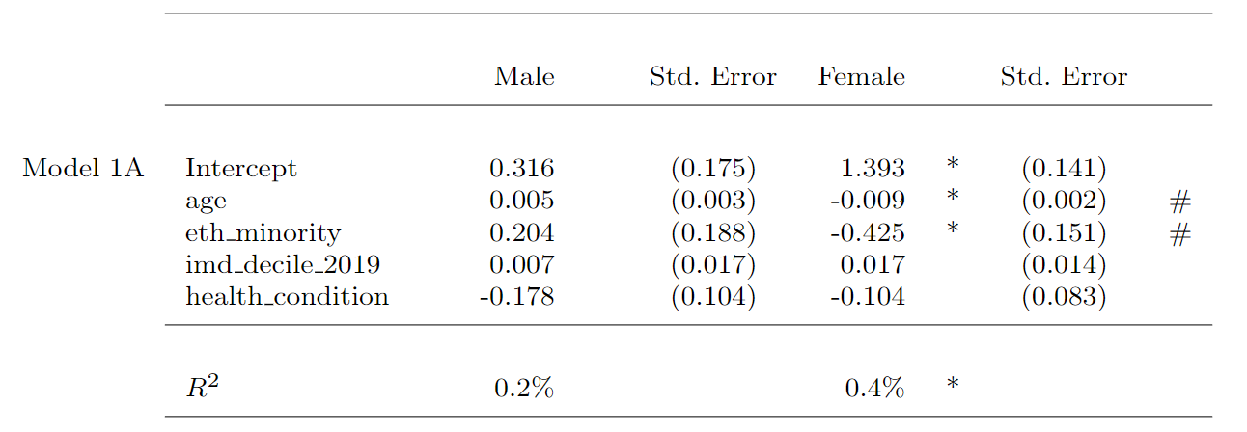
Predicting the decline in wellbeing

Slide 9
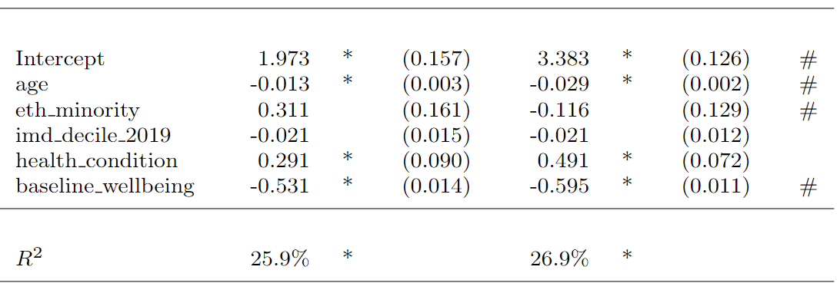
Predicting the decline in wellbeing

Slide 10
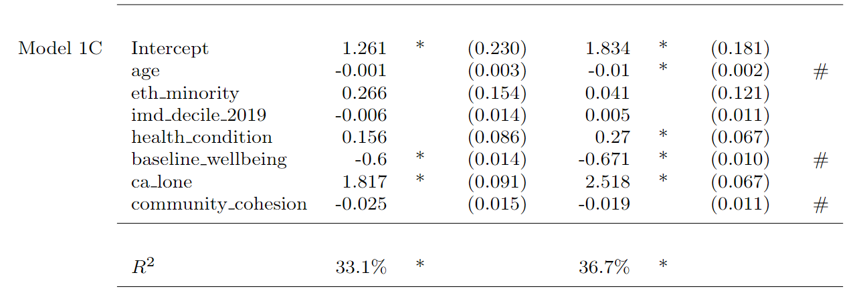
Predicting the decline in wellbeing

Slide 11
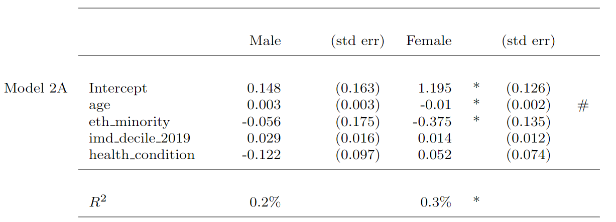
Predicting the recovery

Slide 12
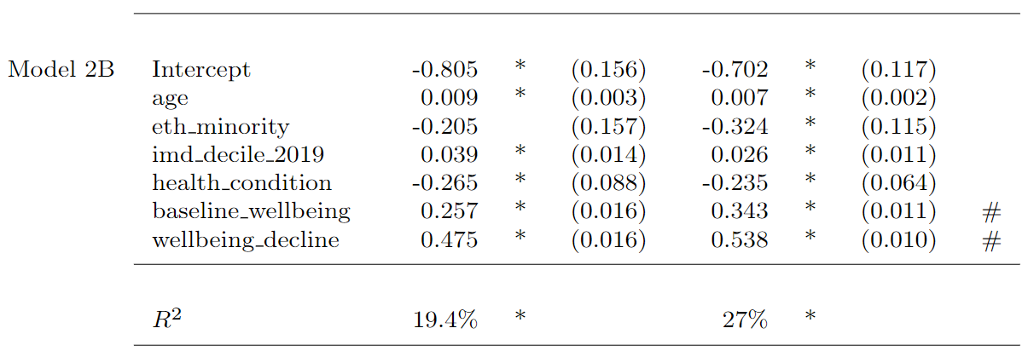
Predicting the recovery

Slide 13
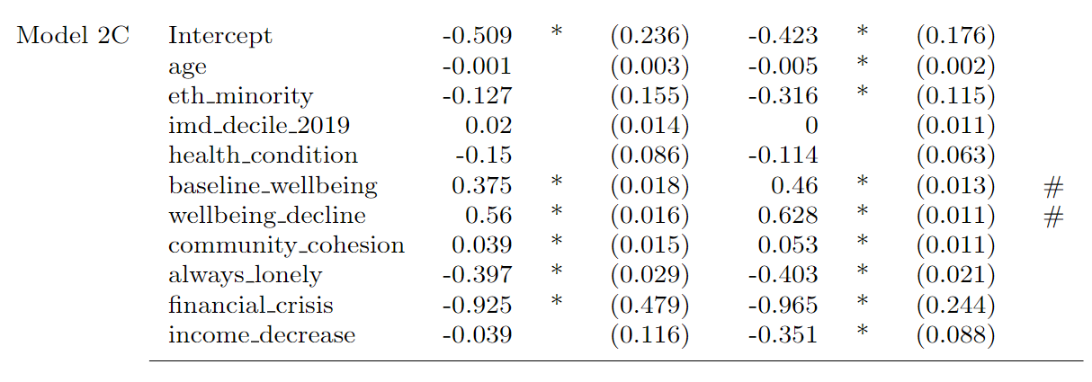
Predicting the recovery

Slide 14
Conclusions
A decline in well-being was observed at the beginning of the
first lock down period at the beginning of march 2020.
This was matched with a corresponding recovery between april and july as restrictions were gradually lifted.

Slide 15
Conclusions
There was no association between the decline and deprivation, nor between deprivation and recovery.
The strongest predictor of decline in well-being during the lock down, was the baseline score:
  with the counterintuitive finding that for those with pre-existing poor well-being, the impact of pandemic restrictions on mental health were minimal,
  but for those who had previously felt well, the restrictions and the impact of the pandemic on well-being was greater.
For recovery The baseline, the degree of decline, new economic hardship, ands reporting of loneliness were all important factors

Slide 16
CAVEATS
IMD is at the LSOA level – may not be fine grained enough.
Findings conflate: Background effects of the pandemic, lockdown, personal effects of the pandemic
Sample
  Significant attrition between the main survey and the covid survey.

Slide 17
REFERENCE
Murphy, J., & Elliot, M. (2022). An analysis of changes in wellbeing during the COVID-19 pandemic in the UK. Discover Social Science and Health, 2(1), 1-19.

